Slide 1
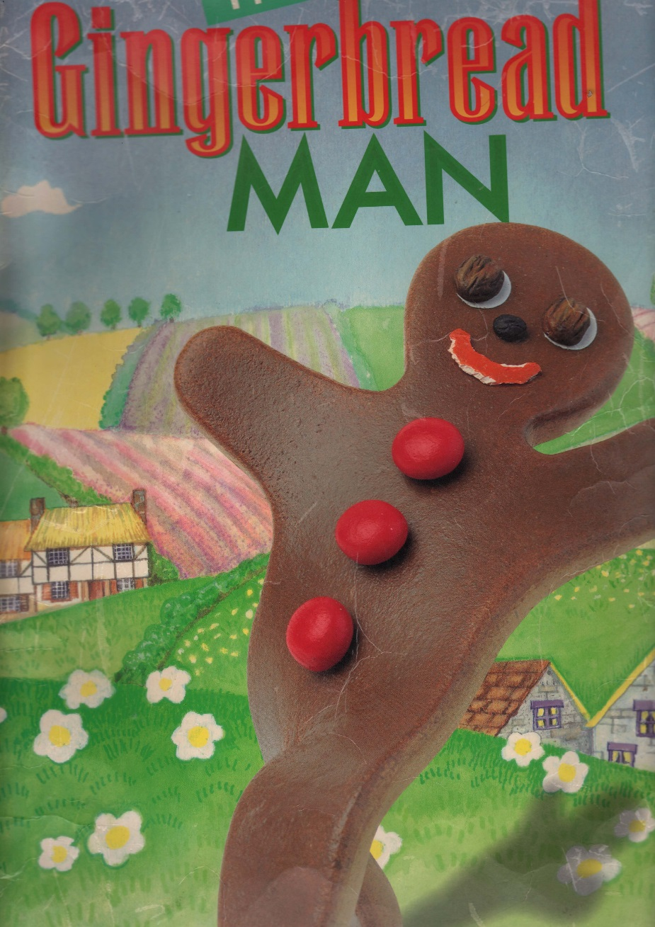

Slide 2
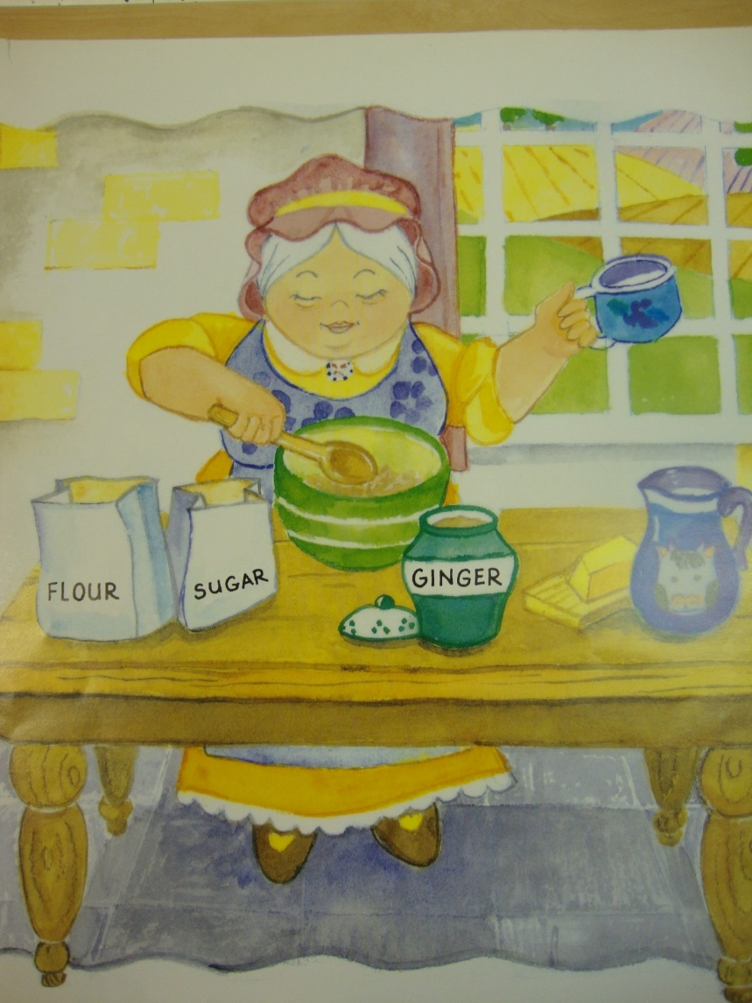
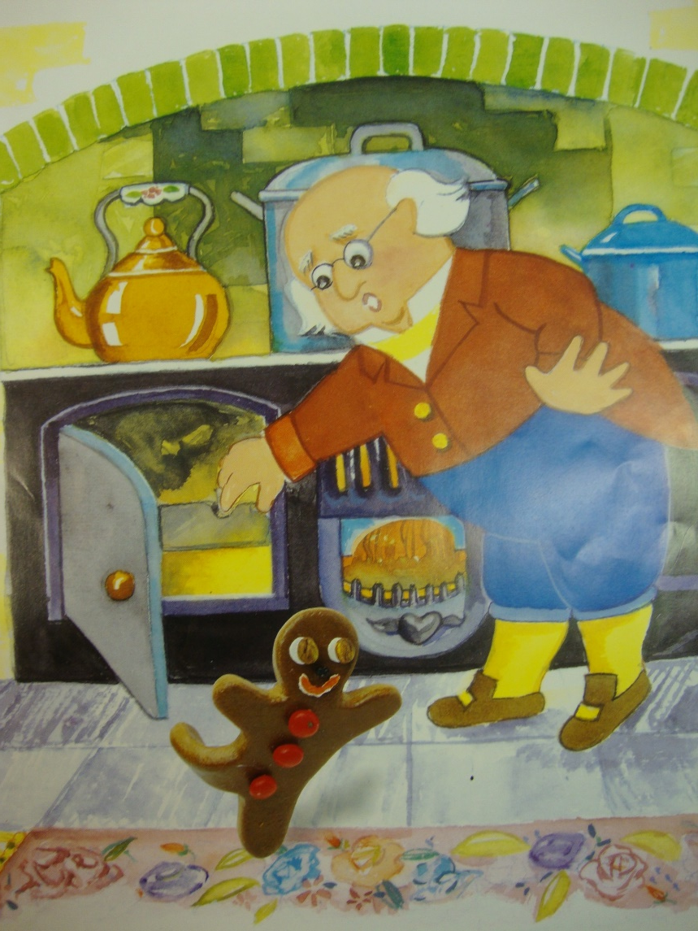
The old lady made a boy one day
Who leapt from the oven ready to play.

Slide 3
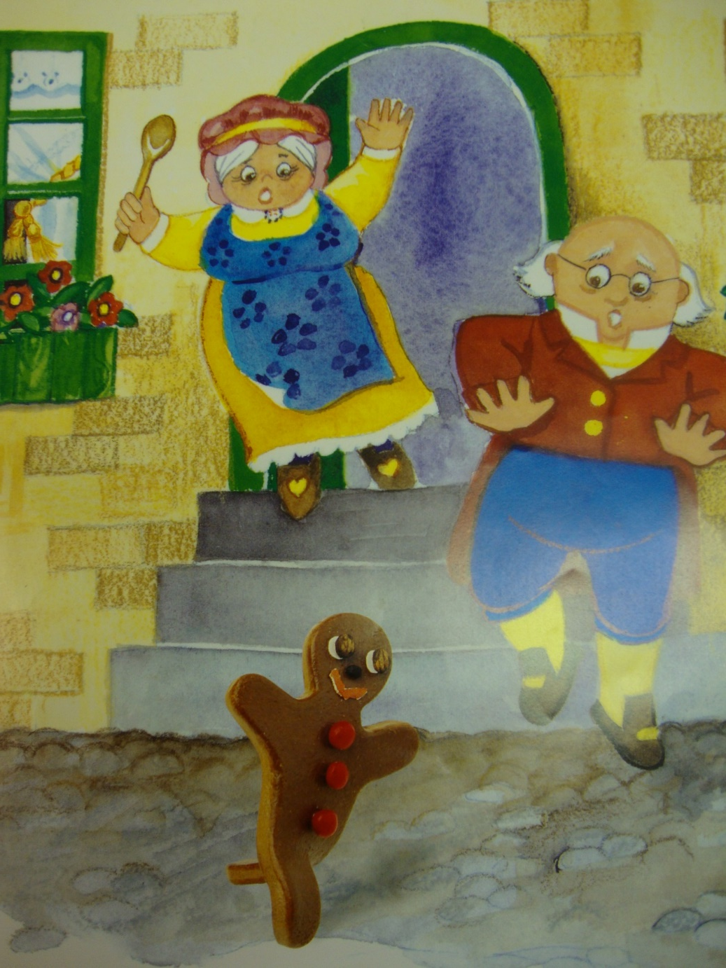
She and her husband were ready to eat
The gingerbread man who had run down the street.

Slide 4
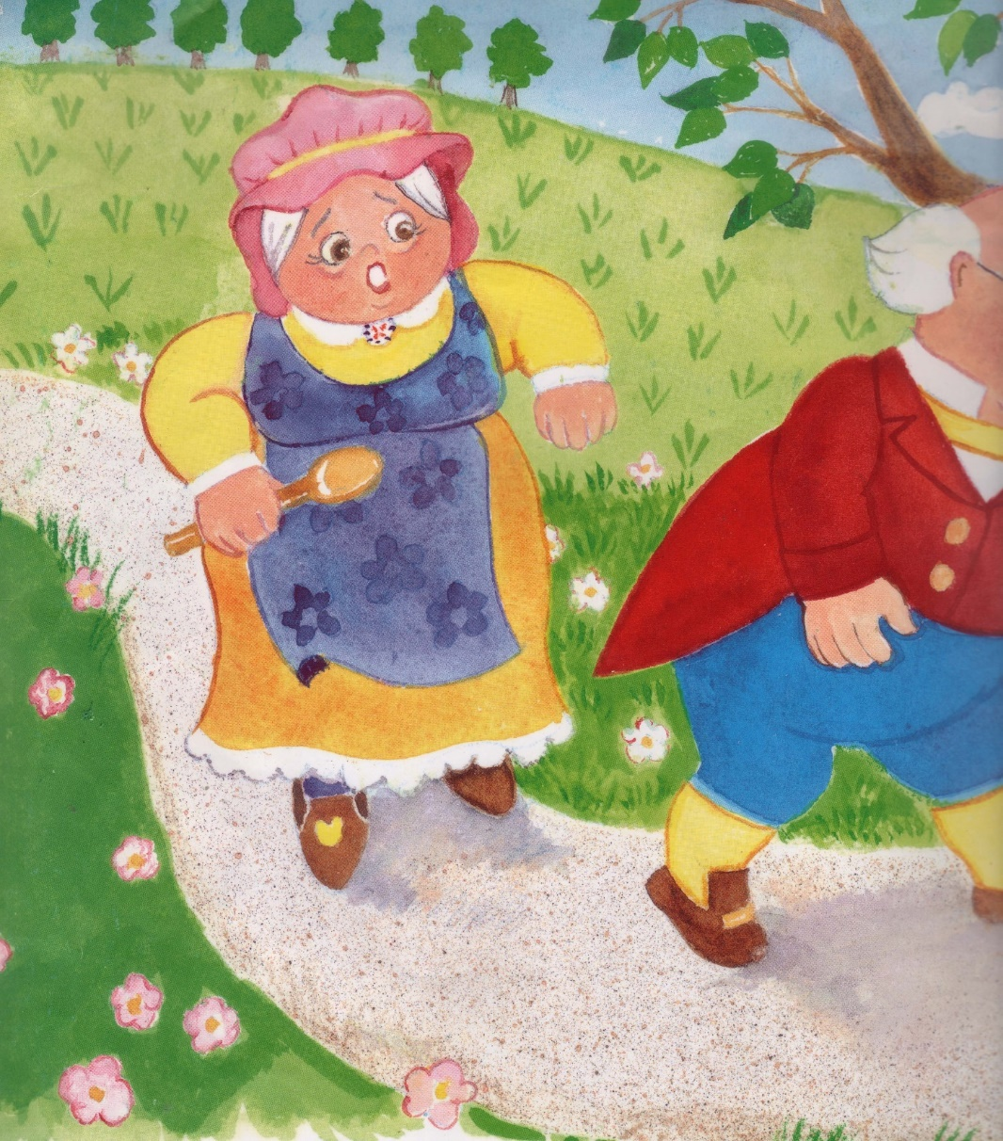
“Run, run, run as fast as you can,
You can’t catch me, I’m the gingerbread man!”

Slide 5
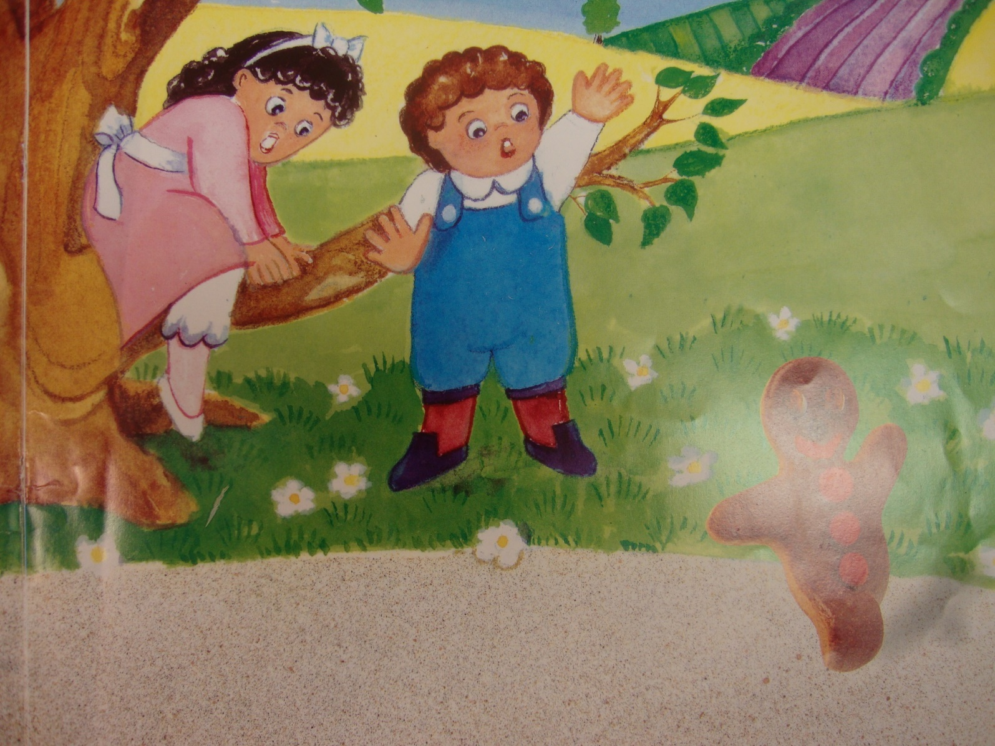
A boy and girl both joined the chase,
But the gingerbread man, with a smile on his face,

Slide 6
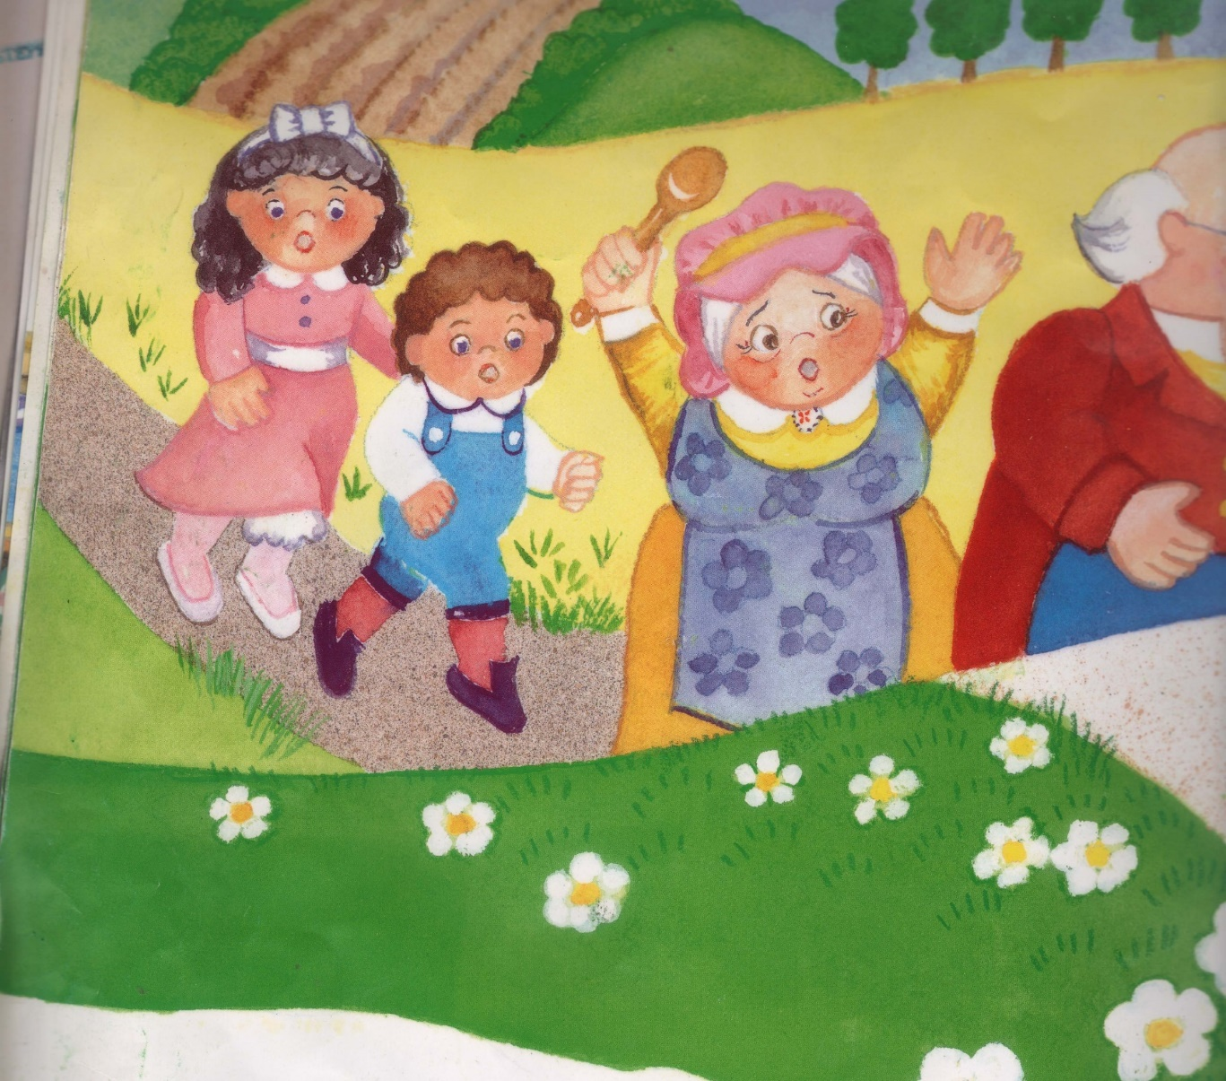
Said, “Run, run, run as fast as you can,
You can’t catch me, I’m the gingerbread man!”

Slide 7
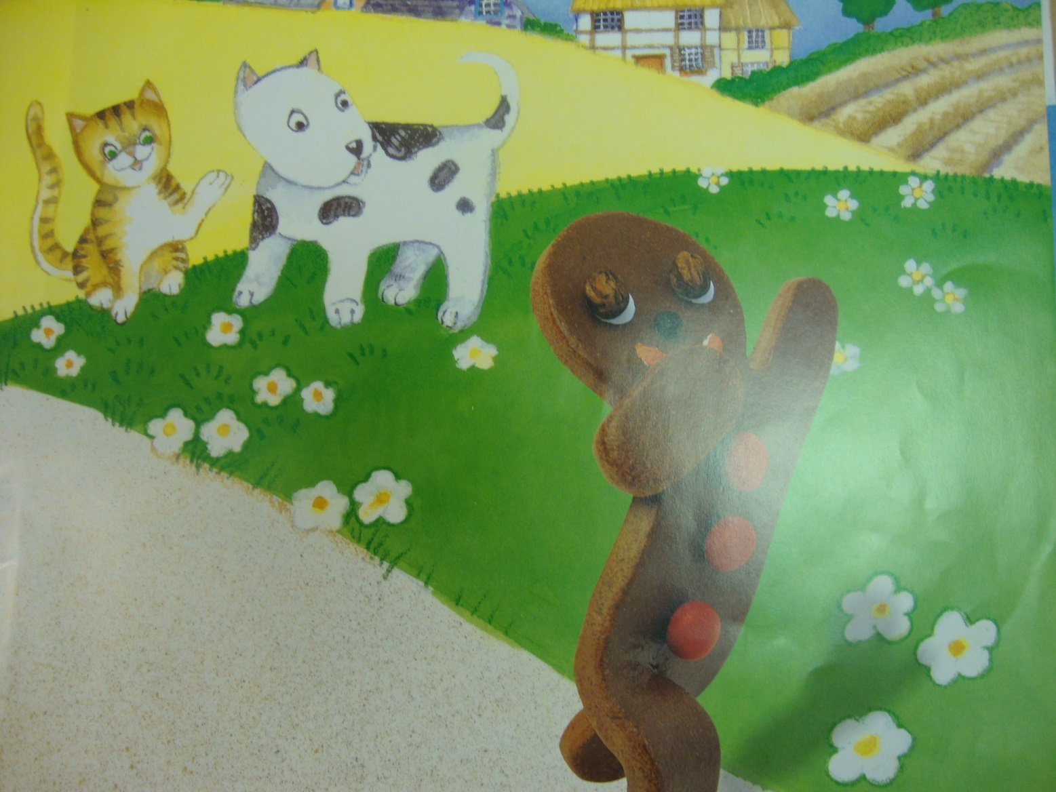
A cat and a dog both joined the chase,
But the gingerbread man, with a smile on his face,

Slide 8
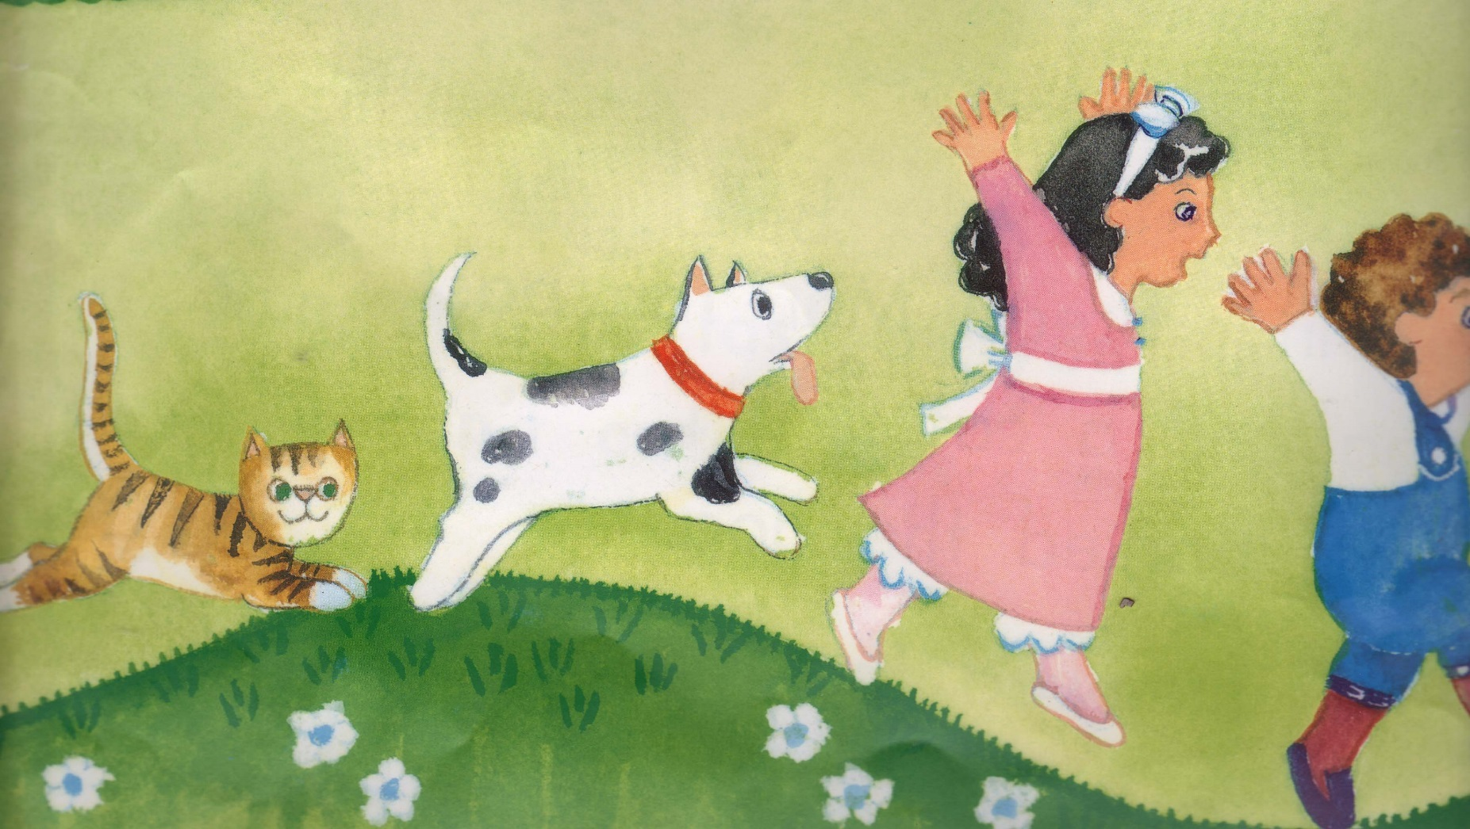
Said, “Run, run, run as fast as you can,
You can’t catch me, I’m the gingerbread man!”

Slide 9
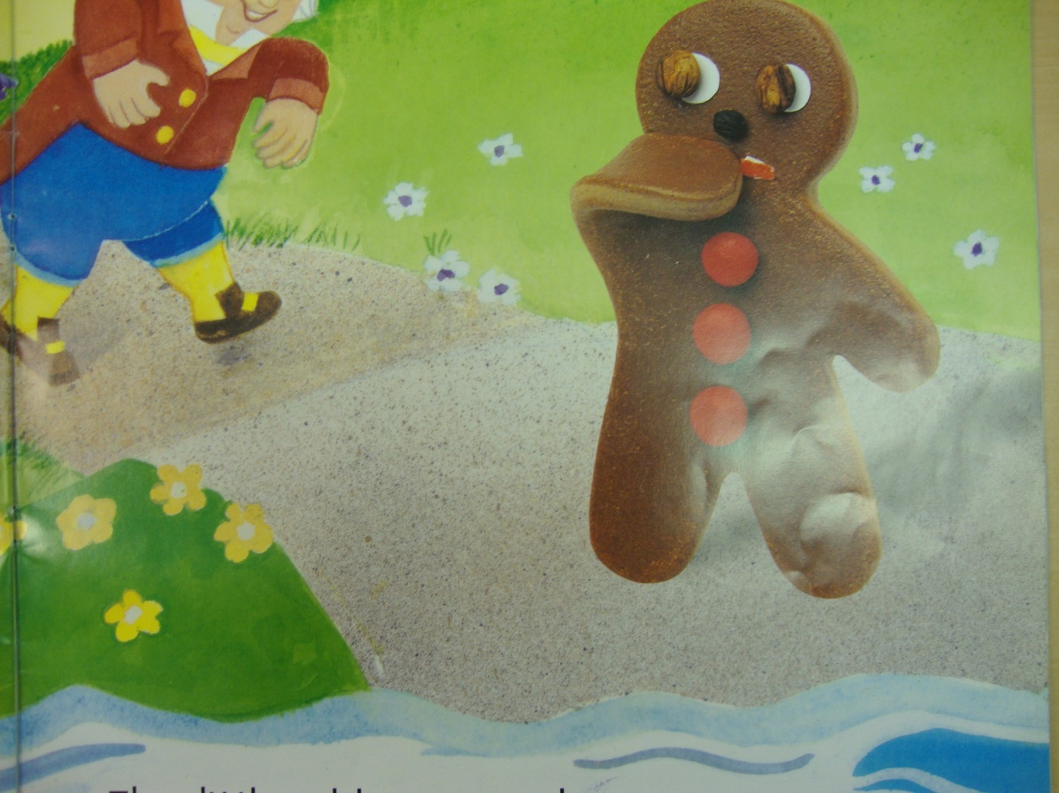
He came to a pond that blocked his path
And gingerbread men don’t like to bath.
Out jumped a fox who said, “hop on,
I will take you safely across the pond."

Slide 10
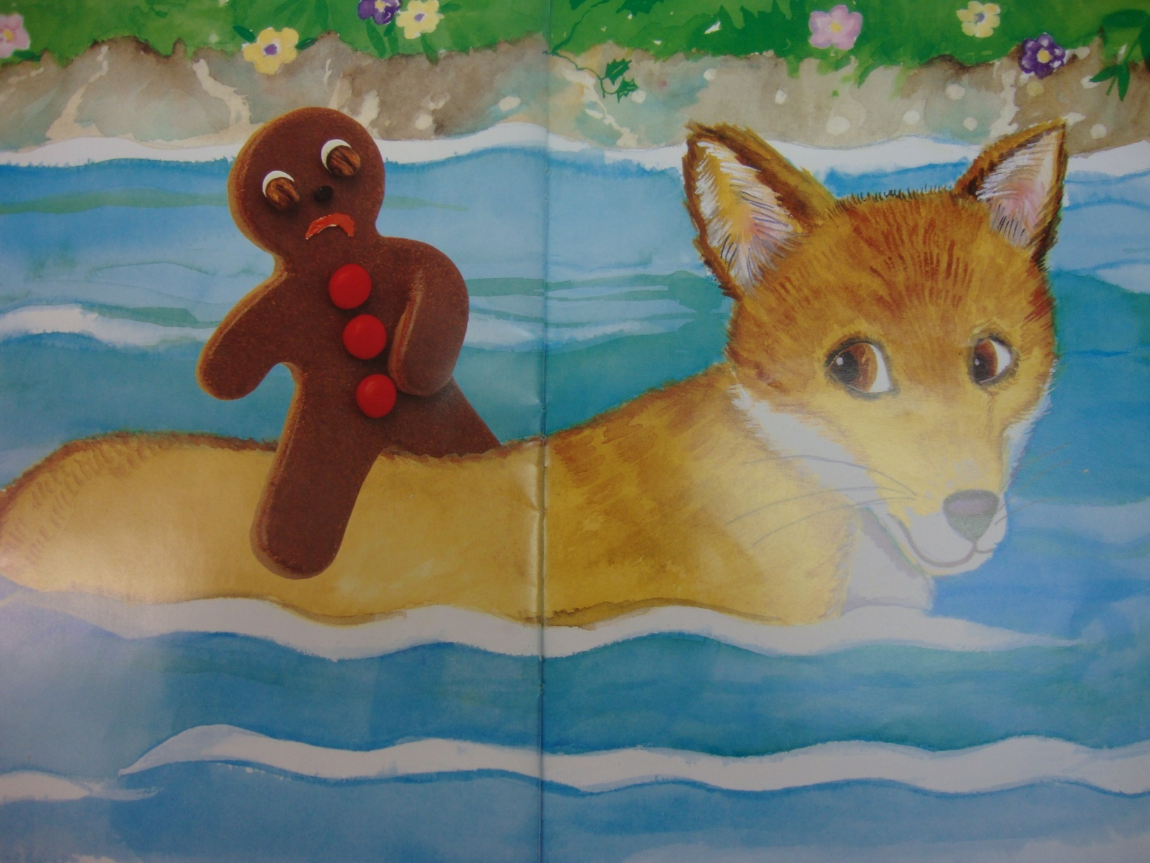
He climbed up onto the fox’s back,
Who licked his lips and wanted to snack.

Slide 11
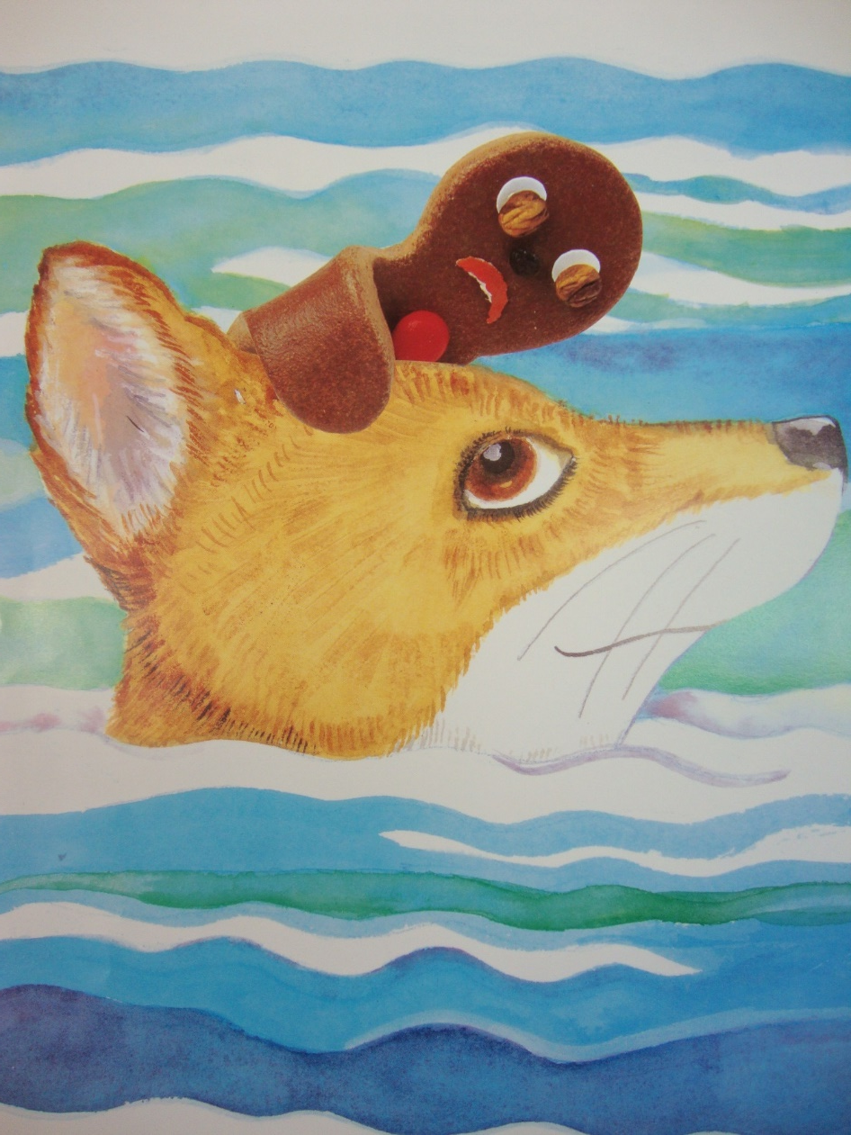
He climbed onto the fox’s head,
Who loved the taste of gingerbread.

Slide 12
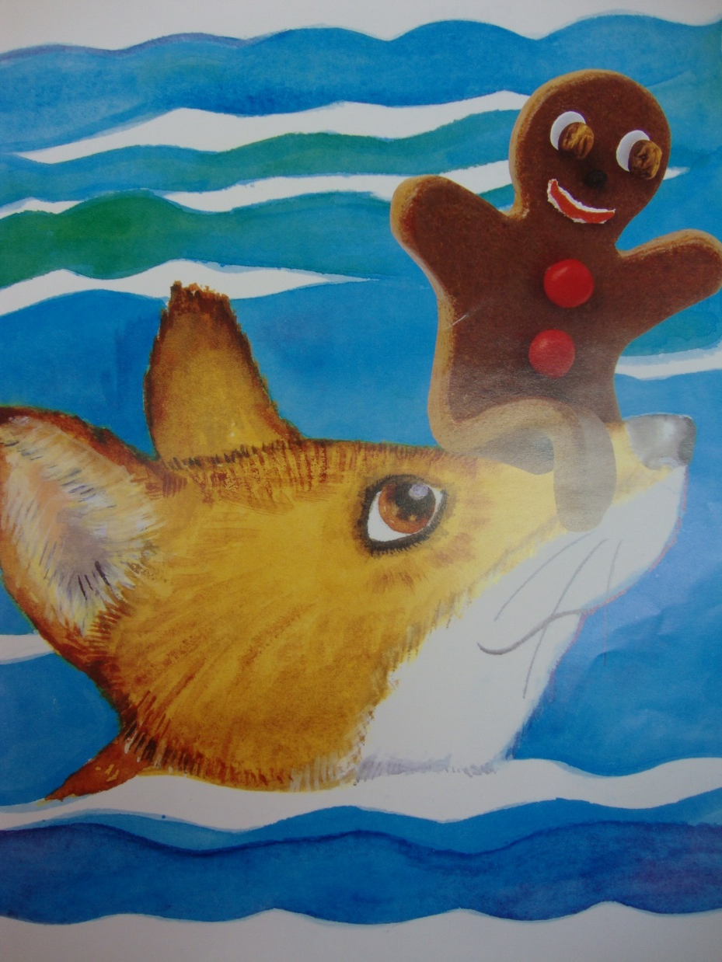
He climbed up onto the fox’s nose
To stop the water from touching his toes.

Slide 13
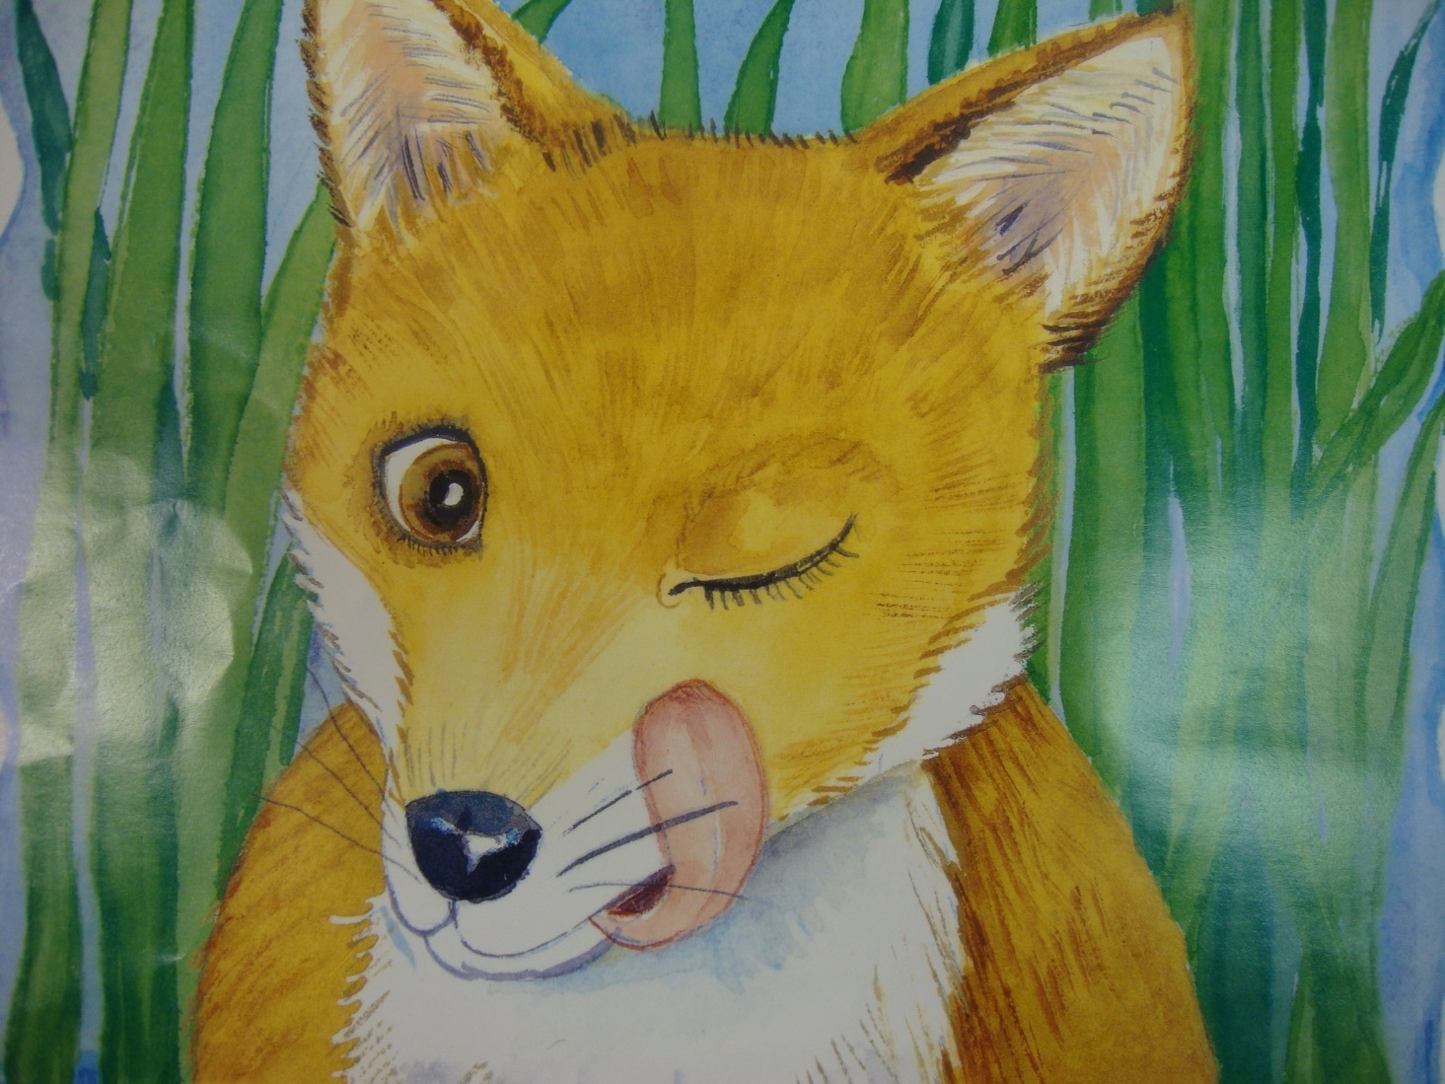
SNAP! SNAP! SNAP! was the fox’s plan,
And that was the end of the gingerbread man.

